Slide 1
Making RTP More Reliable
Classroom Presenter 3.0
Peter Davis

Slide 2
Two Extremes
Unreliable transmission
  Packets received out of order
  Packets dropped
  By default, RTP has no mechanism to reorder packets or request “replacement” packets

Slide 3
Total Reliability (TCP-style)
Each packet has a sequence number
Each packet “depends” on the previous packet
  If a dependency is unsatisfied, a message is sent requesting rebroadcast of the missing dependency
  All incoming packets are queued until replacement is received

Slide 4
So What’s the Beef?
We could implement a TCP-style control protocol on top of RTP
  There are even a few existing RFCs on this subject to point us in the right direction
Absolute network reliability is always the safest choice from the application’s perspective
But does this make sense for Presenter?
  Why not? [discussion]

Slide 5
Reasons “Why Not”
Some packets don’t “depend” on others
  Is this really true?
We want to optimize responsiveness of certain features even during periods of poor network performance
  A dropped packet shouldn’t hold up the show
But what types of packets are truly independent?

Slide 6
Possible Examples
(I say “possible” because there might be unanticipated dependencies)
A slide transition message does not depend on ink still being broadcast to the previous slide
Ink doesn’t depend on slide image content
  In fact, probably nothing depends on image content
  But it does depend on:
    The existence of the slide
    The existence of all of the slide’s annotation sheets (to ensure they’re layered in the correct order)
    The existence of all previous ink strokes on the same annotation sheet (again, for rendering order)
Independence is much less common than dependence
  Is this a “premature optimization”?

Slide 7
Compromise
I propose we implement TCP-style control and reliability
But with the modification that a packet does not only have to depend on the previous packet
Packets can specify a single sequence number on which they “depend”

Slide 8
What does “depend” mean?
A dependency is unsatisfied if the packet whose sequence number is specified:
  Has not been received
    (Out-of-order packets reduce to this case)
  Has been received but recursively has an unsatisfied dependency

Slide 9
How are dependencies resolved?
Packets with unsatisfied dependencies are entered into a table
  Mapping from dependent sequence number to a stack of dependent packets
  Every time a packet is received, the stack is fetched from the table
  If the new packet is in turn unsatisfied, it is pushed onto the stack and entered back into the table on its own dependency

Slide 10
How Are Packets Sent?
By default, this reduces to “TCP-style” reliability by depending on the previous sequence number
We define which types of packets are partially independent
We add logic to the sending queue to record the sequence number of the last packet on which these packets might depend

Slide 11
How do you know if a dependency is satisfied
Keep a list of ranges of received packets
Under good conditions, there is one contiguous range
If packets are dropped, ranges are segmented
As dropped packets are recovered, ranges are merged
  (Have we actually discovered an application of union-find?)

Slide 12
How are packets recovered?
The sender keeps a buffer of recently sent packets
Messages are sent back to the sender requesting ranges of missing packets
The sender merges these ranges with requests from other hosts
The sender rebroadcasts the packets if they are available

Slide 13
What If Packets Cannot Be Recovered?
Since there is no “ACK” after every packet, the sender must eventually discard data
Sender replies with “cut-off point”
  The first sequence number it has in its buffer
Recipient discards all packets that depend on sequence numbers less than the cut-off
  Keeps a list of ranges of discarded packets and recursively discards sub-dependents

Slide 14
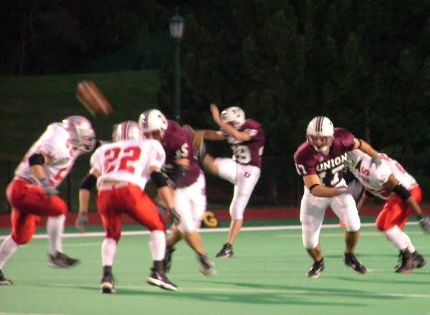
Multi-Host Dependencies
Suppose a public display receives a student submission directly from a student
The student submission slide depends on information broadcast by the instructor
These dependencies are probably too complex to resolve

Slide 15
What Do We Gain?
Independent packets don’t get “hung up” on irrelevant dropped packets
Application-wide reliability
  Not just for special cases like ink

Slide 16
What Do We Lose?
Complexity
We still worry about unrecoverable data
  But would happen less frequently, so could be dealt with more harshly
We still worry about joining a presentation “late”

Slide 17
Why Not Special-Case Ink?
Special-cases are ugly when other components suffer from the same problems
By setting dependencies on all non-Ink packets to “0”, this proposal would be equivalent to a special-case on ink
Not very much more work

Slide 18
Can We Live Without Reliability?
No. Well, maybe.
Presenter 2.0 does it.

